Slide 1
Modeling control strategies: vaccination
Cristina Lanzas
CBS 810 Infectious disease modeling

Slide 2
Learning objectives
List possible vaccine effects on disease dynamics
Define herd immunity and the vaccination critical threshold
Describe the infectious disease dynamics in a population with random vaccination
Explain how vaccines can be imperfect and its implications on disease dynamics
List benefits and drawbacks of targeted vaccination

Slide 3
Vaccines
Vaccines help develop immunity by imitating an infection.
Types of vaccines:
Live, attenuated vaccines (weakened living virus, e.g. measles, mumps and rubella vaccine)
Inactivated vaccines (killed virus, e.g. polio)
Toxoid vaccines (weakened toxins, e.g. tetanus)
Subunit vaccines (parts of the virus or bacteria, e.g. pertussis)
Conjugate vaccines (antigens on the bacteria outer coating, e.g. Haemophilus)

Slide 4
Vaccine effects
Direct effects: to protect vaccinated individuals against diseases
Indirect effects: to reduce transmission of infection, and protect even non-vaccinated individuals.
Notes:
Vaccines have two effects:
At the individual/direct level, they protect vaccinated individuals against diseases.
But vaccines have also indirect effects at the population level. Widespread vaccination reduce transmission of the infection in the population, thus protection even the non-vaccinated individuals. These indirect protection is what we call herd immunity.

Slide 5
Types of vaccine effects
Halloran et al., Design and analysis of vaccine studies 2009

Slide 6
Herd immunity
Disease can be excluded from a population if the proportion of immune individuals is sufficient to prevent transmission
It is not necessary to immunize everyone in order to eradicate an infection
The principle of herd immunity, therefore, lies on the fact that exist a threshold in the proportion of susceptibles necessary to cause an epidemic
Notes:
Another way to define herd immunity: The phenomenon for which the disease can be excluded from a population if the proportion of immune individuals is sufficient to prevent transmission. This was a big realization for disease control. To eradicate an infection is was necessary stop transmission, but for that it wasn’t necessary to immunize every single individual in the population. The basis for the herd immunity is the existent of a threshold in the proportion of susceptible necessary to cause an epidemic (the epidemic threshold), herd immunity is achieved by maintaining the number of susceptible below the threshold

Slide 7
The fraction of susceptible individuals in the population needs to be sufficiently small to decrease incidence and prevent the spread of the infection (i.e., dI/dt ≤ 0),
To prevent the spread of the infection, the proportion of susceptibles (s) has to meet the following:
Notes:
Let’s now derive the threshold formally. So the fraction of susceptible individuals in the population needs to be sufficiently small to decrease incidence and prevent the spread, which means that the change of infectious individual on time has to be 0 or negative.
At the limit 0, we can rearrange the equation, we move I on the right, parameters on the left, and we obtain the following expression you have seen before, beta*susceptibles divide by the recovery rate plus the exit rate. Which is the basic reproduction rate when all the population is susceptible or the effective reproduction rate when part of the population is susceptible. Here we define small s as the proportion of susceptibles at which R is 1, we can isolate s and we obtain the epidemic threshold. From a control point of view, the proportion of susceptibles has to be less than 1/R0 to prevent the spread of the infection.

Slide 8
What proportion of the population we need to vaccinate to eradicate a disease in a population ?
The critical vaccination proportion that will achieve eradication, p_{c,} is that for which the basic reproduction number under vaccination (R_{v}) is just equal to 1.
Remember, is the minimum proportion of susceptibles necessaries to cause an outbreak

Slide 9
Numerical values of the basic reproduction number and the critical vaccination proportion, pc
Scherer, A. & McLean, A. Mathematical models of vaccination. Br Med Bull 62, 187-199 (2002).
Notes:
Let’s look at some empirical values on the basic reproduction number for some childhood diseases. Let’s look at the two extremes. For measles, the estimates of the basic reproduction number are high, around 18, it is considered one of the most highly transmissible of all directly transmitted diseases in humans. which gives you a vaccination threshold of 94 %, as you can imagine achieving vaccine coverage higher than 94 % in a population is very challenging. On the other extreme, smallpox has a much lower R0, 2.3 in this estimate from West Africa. To date, it is the only successfully eradicated diseases. WHO recommended reaching vaccine coverage of 80 %..

Slide 10
Anderson et al. Lancet 350: 1466-70 (1997)

Slide 11
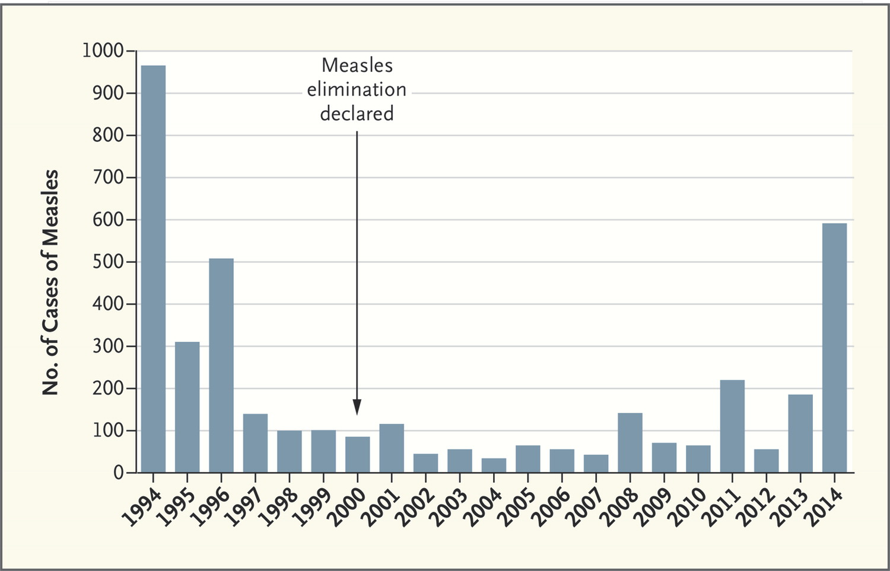

Orenstein W, Seib K. N Engl J Med 2014;371:1661-1663.
Measles Cases in the United States, 1994–2014.
Notes:
Measles Cases in the United States, 1994–2014. The 2012, 2013, and 2014 data are provisional data reported to the Centers for Disease Control and Prevention National Center for Immunization and Respiratory Diseases. The 2014 data are for January 1 to August 29.

Slide 12
Life-long immunity, sterilizing immunity (pediatric vaccination)
S
unvaccinated births
infections
deaths
I
infections
recoveries
deaths
R
vaccinated births
recoveries
deaths

Slide 13
Infection disease dynamics under vaccination
Change frequency of epidemics
Relapse after a ‘honey-moon period’
Eradication
Notes:
Vaccine coverage below the vaccine threshold modify the infection dynamics. Here we have represented three vaccine coverage, on green above the threshold, blue, below the threshold but close, and red well below the threshold. So we see that vaccination coverage above the threshold achieve eradication, as the reproduction number drops below 1. What happen when the coverage doesn’t reach the threshold? After the mass vaccination program starts, the number of cases drops.
The honeymoon refers to the period of very low incidence immediately following the introduction of a mass vaccination programme. Because of these high levels of immunity
among older individuals due to natural transmission, the initial impact of a vaccination programme will look very promising. After the initial period
of very low incidence, epidemics restart due to the slow accumulation of susceptibles that eventually reach the epidemic threshold.
When the level are well below the threshold, honeymoon periods are not observed, but frequency of the outbreaks may change.

Slide 14
Mass random vaccination program
Implies,
vaccination in a homogenous population with random mixing with a vaccine that provides 100 % perfect immunity given at birth
But,
Heterogeneous population, non-random mixing
Imperfect vaccines
Duration of the immunity and life span of the host
Maternal immunity and vaccination window
Notes:
So far we have learnt the importance of R0 in predicting vaccine coverage, and how with a very simple expression we can derive the vaccine threshold. Now there is a lot of assumptions implicit in this expression, including that we have assume we are doing a mass vaccination in a population that is homogenous and the mixing is random, with a vaccine that is perfect, provides 100 % immunity when given at birth. But, that live, things are more complicated, and so in reality we are dealing with vaccines that are imperfect, so they do not provide 100 % immunity or only are able to elucidate partial immunity compare to the natural infection, or the duration of the immunity elucidate by the vaccine is shorter compare to the life span (p.e. for measles, the natural infection confers almost life-long protection, the immunity provide by the vaccine is much shorter). Another complication is the presence of maternal immunity. We can not immunize animals immediately after birth because of the interference with the maternal immunity. And so often in our vaccination programs we will consider repeated vaccination schedule or we may considered target specific groups, specially when the population is heterogeneous, and some individuals may be more at risk than others.

Slide 15
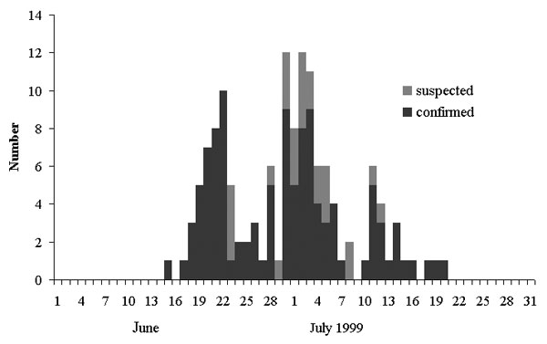
Heterogeneous Populations-Nonrandom Mixing
Measles Outbreak in a Community with Very Low Vaccine Coverage, the Netherlands
Overall attack rate was 37%:
213 clinical cases among the 255 participating pupils and 327 household members.
National coverage: 96 %
School coverage: 7 %
van der Hof. Emerg Inf Dis (2001) 7: 593

Slide 16
Imperfect vaccines
When vaccines do not provide complete protection and/or the protection wanes over time, vaccines are considered imperfect and may have different vaccines effects.
For imperfect vaccines the critical proportion of individuals to be vaccinated needs to be adjusted for the vaccine impact (θ).
Notes:
In reality, vaccines we deal with are imperfect (by that we means, vaccines that do not provide complete protection or the protection wanes over time. Vaccines in fact can have different effects; they may have an impact on the infectiousness, or protect for clinical disease or not infection. For imperfect vaccines, the threshold values need to be adjusted to the vaccine impact. Here represented by theta. The new critical proportion of individuals to be vaccinated is now 1/theta times 1 minus the inverse of Rnot.

Slide 17
Imperfect vaccines: Waned immunity
S
V
Waned immunity, ω
I
R
μ/(μ+ω) is the fraction of a lifetime for which an individual is protected by a vaccine that gives immunity that wanes at rate ω in a population with death rate μ.

Slide 18
‘Leaky’ vaccines
(= Type I, failure in degree)
Vaccines reduce the instantaneous infection rate in all the vaccinated individuals by a constant proportion
‘All-or-none’ vaccines
(= Type II, failure in take)
Vaccines provide a constant proportion of individuals with complete immunity to the disease (i.e., protection is heterogeneous)
Immunity provided by the vaccine wanes on time
Notes:
The vaccination impact is a function of the different vaccine effects and can take different expressions. We can have different types of imperfect vaccines. Vaccines can be leaky, also know as failure type I or failure in degree, meaning that vaccinated animals can still be infected, although at a lower rate compare to non-vaccinated animals, with a reduced infection rate, phi. Vaccines can also be all-or-none (also known as type II or failure in take). As the name indicates, animals receiving the vaccine either protects or failure in take and do not provide any immunity at all. Finally another form of imperfection is that the immunity wanes on time, does vaccinated animals become eventually susceptibles again. So Imagine for a vaccine that has all three types of failures, the expression of the vaccine impact is alpha, which is the proportion of vaccinated animals in which the vaccine takes, times phi (the degree of protection that the vaccine confers against infection) times the ratio between the exit rate (the inverse of the lifetime) and the rate at which the immunity wanes.

Slide 19
S
I
R
X
Y
Z
S: susceptible, I: infectious, R: recovered, X: susceptible vaccinee,
Y: infectious vaccinee, Z: recovered vaccinee

Slide 20
We include three vaccine effects:
Vaccine effect on the reduction of susceptibility (q)
Vaccine effect on the reduction of the length of infectious period (h)
Vaccine effect on the infectiousness (g)
Proportion of replacement vaccinated
Vaccine effect on the reduction of susceptibility
Vaccine effect on the reduction of the length of infectious period
Vaccine effect on the infectiousness

Slide 21
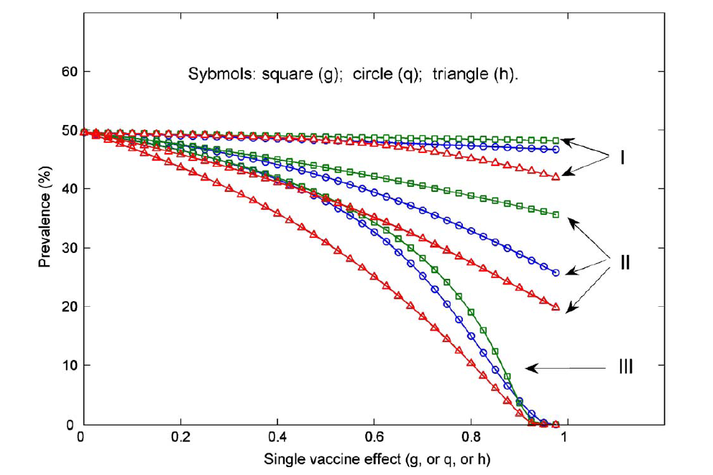
Vaccine effect on the reduction of susceptibility
Vaccine effect on the reduction of the length of infectious period
Vaccine effect on the infectiousness
3 months
1 year
16 years
Lu, et al., J. Theor. Biol., 2009, 259: 770-84

Slide 22
Targeted vaccination
 | Benefits | Drawbacks
Mass vaccination Vaccinate the entire population | Effective at widespread transmission control | Expensive, large numbers
Ring vaccination Trace and vaccinate contacts of suspected cases | Optimizes vaccine use in outbreaks | Needs effective contact/outbreak information
Targeted vaccination Immunize specific groups (high risk) | Effective in protecting specific groups | Needs high levels of herd immunity Difficult to obtain high coverage in specific groups
Notes:
As a final point, one of the assumptions we start with is that the population was homogenous and we were performing a mass vaccination (so the entire population is vaccinated) this approach is effective at control widespread transmission, but of course due to the large numbers involved expensive. Another approaches in which vaccination targets subpopulations are ring vaccination and targeted vaccination. Ring vaccination was for example used in the late stages of vaccine eradication in smallpox and is used when controlling outbreaks. It does a good job in optimizing vaccine, but needs good information on contact/outbreak. In some circumstances we can exploit the presence of heterogeneity in the population (some individuals with high risk of contracting and spreading the disease) to control the disease.

Slide 23
Vaccination
Has direct and indirect (herd immunity) effects
Reduce the reproduction number, so, it increases the age of infection, the inter epidemic periods, and causes a “honeymoon period” after the initial vaccination
Factors to consider in vaccination programs:
Vaccination coverage/Basic reproduction number
Vaccine imperfect ?
Duration of the protection and lifespan
Duration of maternal immunity
Notes:
To wrap up,

